Slide 1
Ch10 Design Patterns(2)
——Information Hiding
——Common and Variation
Software System Design and Architecture
Ding Er-Yu
Software Institute, Nanjing University

Slide 2
Main Contents
Information Hiding
Common and Variation

Slide 3
Information Hiding(1)
Each module has a basic secret: external behavior VS internal implementation
Each module hides the implementation of an important design decision so that only the constituents of that module know the details
  Especially if there is a list of all possible design changes is made - Hiding Assumption List
All design decisions are independent of each other

Slide 4
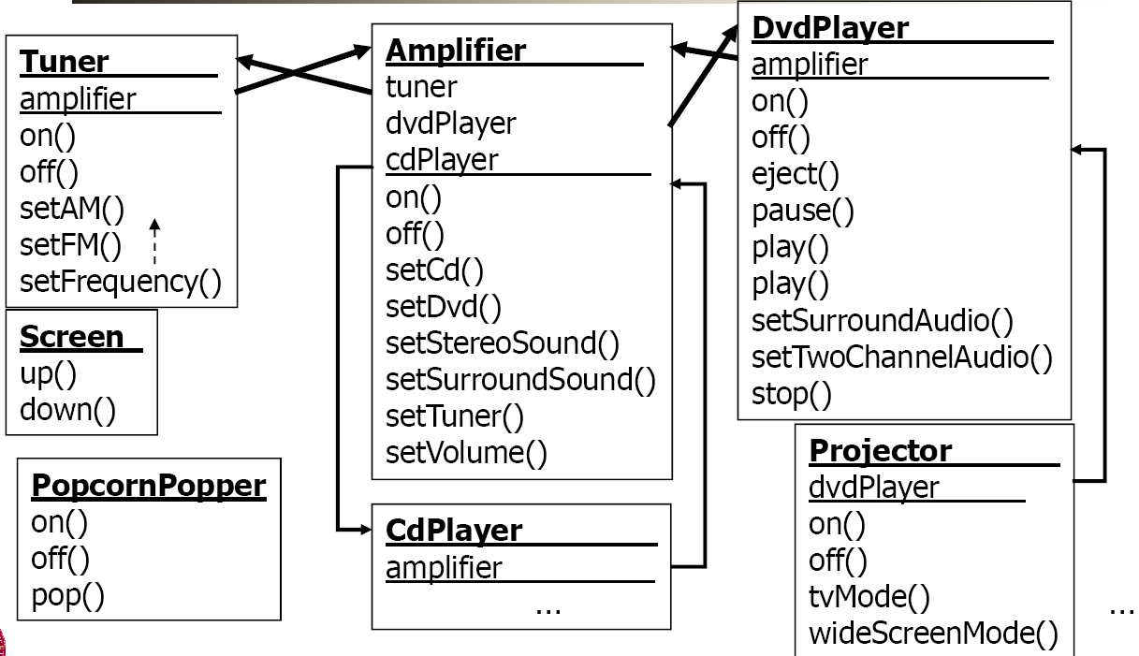
An Module Example
Watching movie
Listen CD
Listen radio

Slide 5
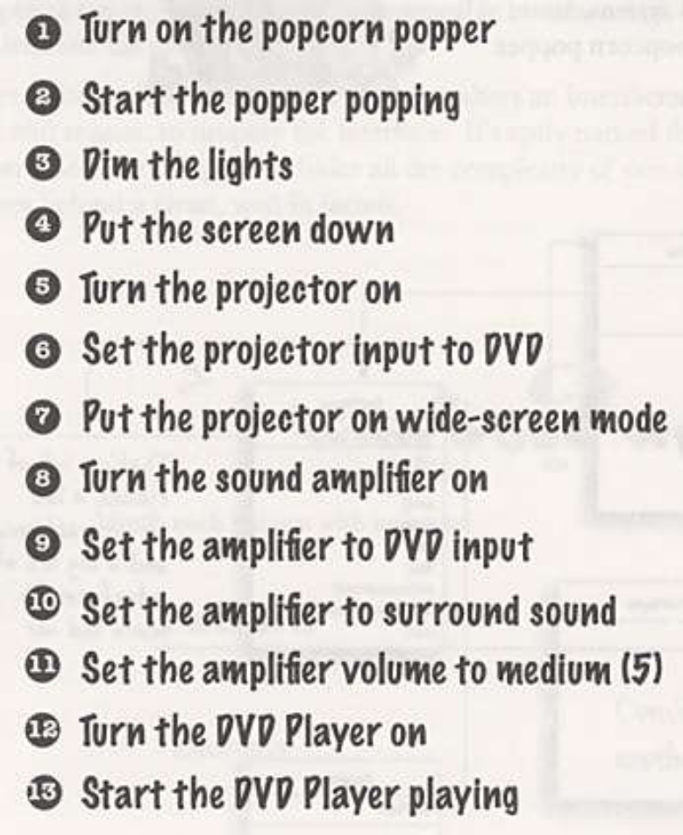
Watching a movie ( hard way)

Slide 6
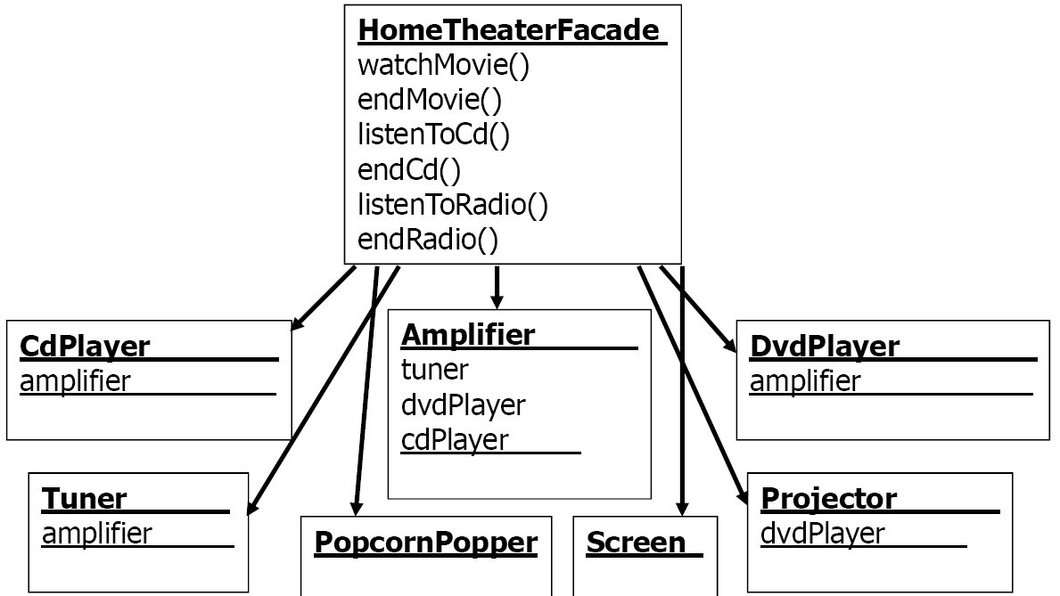
A Facade for Home Theater

Slide 7
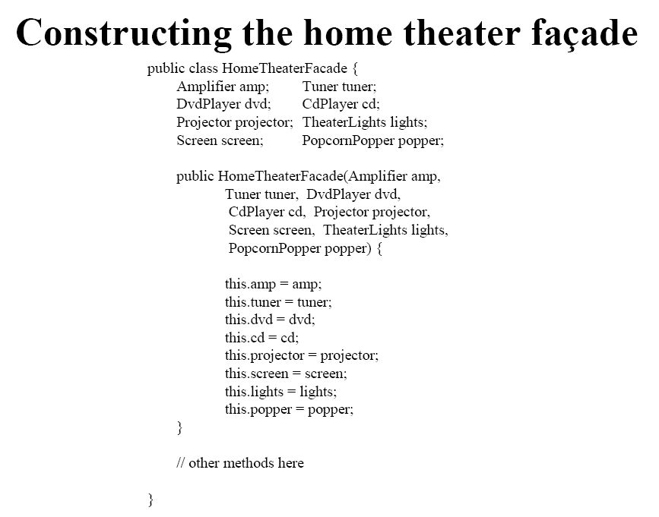

Slide 8
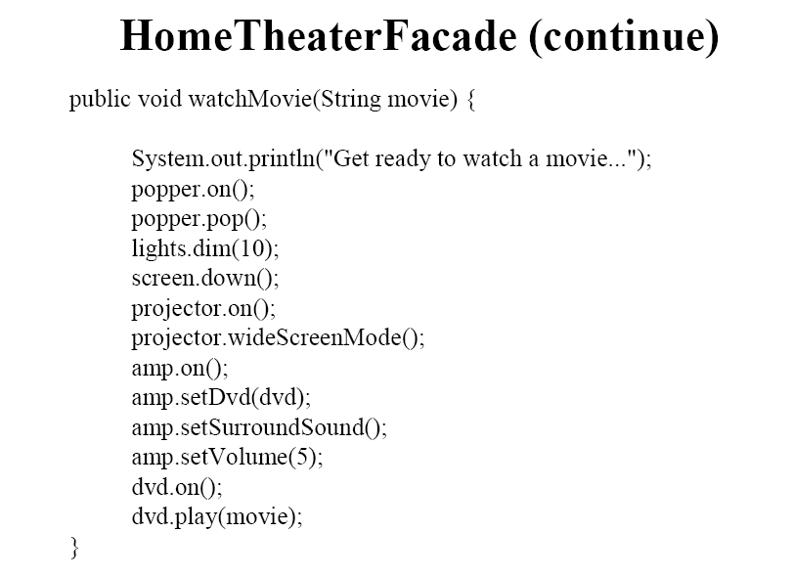

Slide 9
The Facade Design Pattern: Problems
Provides a unified interface to a set of interfaces in a module/subsystem
Defines a higher-level interface that makes the module/subsystem easier to use
  Hiding the internal implementations

Slide 10
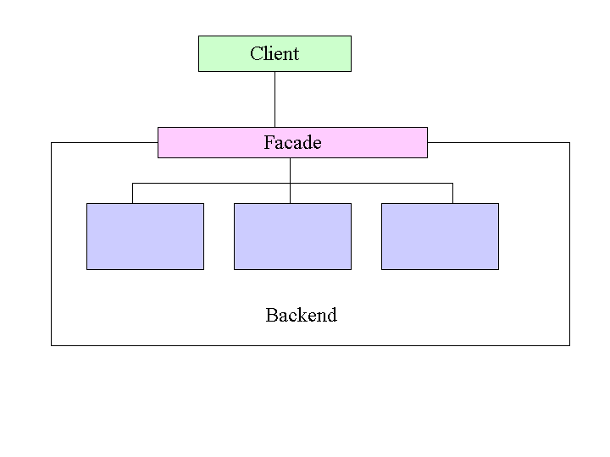
The Facade Design Pattern: Solution

Slide 11
The Facade Design Pattern: consequences
Information Hiding
  it decouples a client from a subsystem of components.

Slide 12
思考题
部分类的整体性→Facade
比较facade与controller(collaboration design)的异同
模块接口与Facade？
UML2.0 类图的复合类

Slide 13
Information Hiding(2)
Modules may have additional secrets: Changes
Anticipate changes
  You then separate each design secret by assigning it to its own class, subroutine, or other design unit.
  Next you isolate (encapsulate) each secret so that if it does change, the change doesn’t affect the rest of the program.

Slide 14
Anticipate changes
Strategy pattern
  Pulling an algorithm out from the object that contains it, and encapsulating the algorithm (the "strategy") as an object
  Establishing an inheritance structure for algorithms

Slide 15
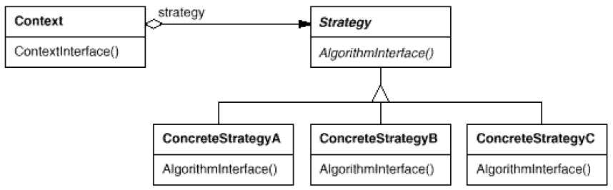
Pattern: Strategy
objects that hold alternate algorithms to solve a problem

Slide 16
思考
在策略模式中， 使用的是“聚合”而不是 “关联”关系！

Slide 17
Main Contents
Information Hiding
Common and Variation

Slide 18
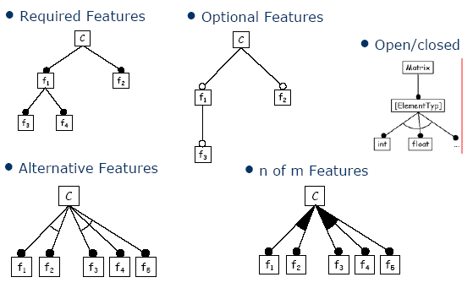
Common and Variation
COMMON
Variation
Variation is more complex than changeability!

Slide 19
Common and Variation: an Example
Describe its structure
Car
Car body
Transmission
Engine
Pulls trailer
Manual
Automatic
Electric
Gasoline

Slide 20
Mechanisms for implementation variation and Common
Polymorphism (Inheritance) 1 of N
  Parent → common
  Child → variation
Aggregate M of N
  Whole→common
  Part→variation
In complex
scenario,
Aggregation
Better!
Conditional statements solutions is the worst !

Slide 21
Common and Variation: an Example
Describe its structure again
Car
Car body
Transmission
Engine
Pulls trailer
Manual
Automatic
Electric
Gasoline

Slide 22
STRATEGY Solution
Context
strategy
Strategy
ContextInterface()
AlgorithmInterface()
ConcreteStrategyA
ConcreteStrategyB
AlgorithmInterface()
AlgorithmInterface()

Slide 23
Strategy Pattern
——Problem
Use the Strategy pattern when
  many related classes differ only in their behavior. Strategies provide a way to configure a class with one of many behaviors
  a class defines many behaviors, and these appear as multiple conditional statements in its operations
  you need different variants of algorithm
  an algorithms uses data that client shouldn’t know about

Slide 24
思考题
如果一个对象集之间除共性外，有超过２个的差异行为，如何处理？
如果一个对象集的部分行为组存在差异性，如何处理？
如果一个对象集的部分属性（以及依赖于这些属性的方法）存在差异性，如何处理？
如果一个对象集的一个行为需要协作对象来完成，但是它们的协作对象存在差异性，如何处理？
如果一个对象集的行为因为属性的取值而存在差异性，如何处理？

Slide 25
State Pattern: Problems
object's behavior depends upon its state
  change behavior at run-time depending upon state
operations have large multipart selection structures - different options for each state
  ⇒ each option in a separate class

Slide 26
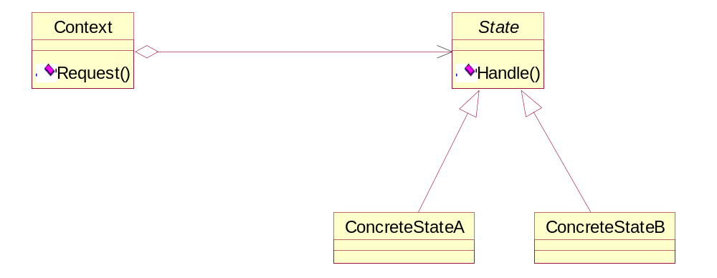
State Pattern: Structure

Slide 27
State Pattern: Collaborations
Context delegates state specific requests to current ConcreteState object
Context - can pass itself as an argument to ConcreteState object
Context - primary interface for clients
  clients - do not need to deal with State directly
Context or ConcreteState object - can decide changing of ConcreteState object

Slide 28
State Pattern: Consequences
localizes state specific behavior
  easy to add new states - new concrete subclasses
  increases size of class structure
makes state transitions explicit
  eliminates potential for inconsistent internal states
state objects can be shared
  if have no instance variables

Slide 29
思考题
比较strategy 与 state
  “1 of N” or “M of N”?
  Who control the changing of variation?
    “Context decide changing of ConcreteState object ”与“ ConcreteState decide changing of ConcreteState object”有何不同？
  How to change?
    Fixed rules or configuration files
  Creating and destroying policy?

Slide 30
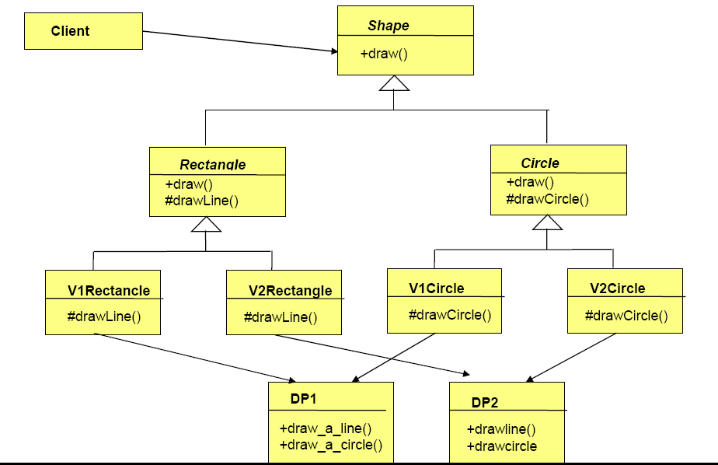
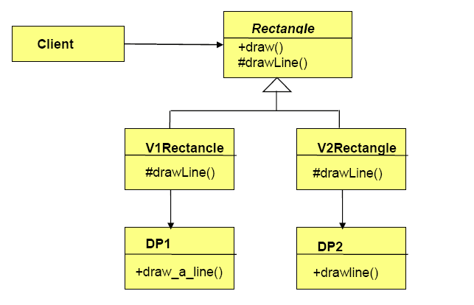
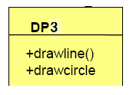
如果接口和实现都存在差异性，怎么办？

Slide 31
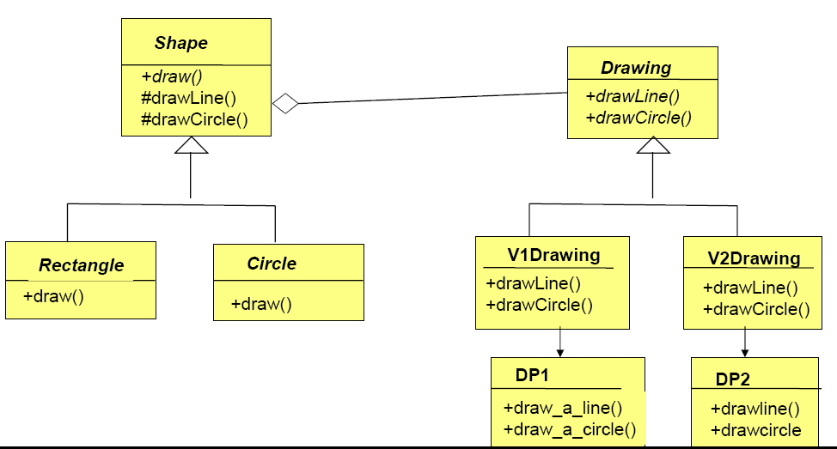
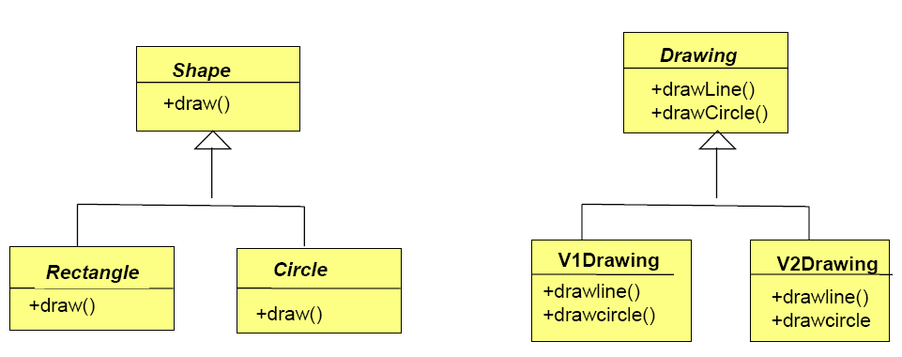
The Bridge Pattern: Solution

Slide 32
The Bridge Pattern: Problem
The normal method of dealing with an abstraction having several implementations is through inheritance.
However, this permanently binds the implementation to the abstraction.
This is not always flexible enough. You may want to modify or extend the abstraction or implementations independently.

Slide 33
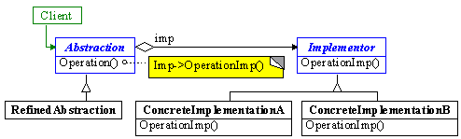
The Bridge Pattern: The Solution
Separate the abstraction class hierarchy from the implementation class hierarchy and use delegation as a bridge between the two.

Slide 34
The Bridge Pattern: Consequences
Decouples interface and implementation.
  Eliminates compile-time dependencies.
Improved extensibility.
Hiding implementation details from client.

Slide 35
思考题
使用Bridge Pattern实现一个画图程序的主体框架
  图形：点、线、矩形、圆…
  线形：实线、虚线、双线…
  线粗细：1x、2x、4x
  颜色：RGB

Slide 36
Any question?

